Slide 1

Introduction to APIs
In R
Reina Chano Murray
JHU Data Services

Slide 3
Agenda
Introduction to APIs
What are they?
Why use them?
Getting started with APIs
What you need
Demonstrations with U.S. Census Bureau APIs

Slide 4
Introduction to APIs

Slide 5


Slide 6
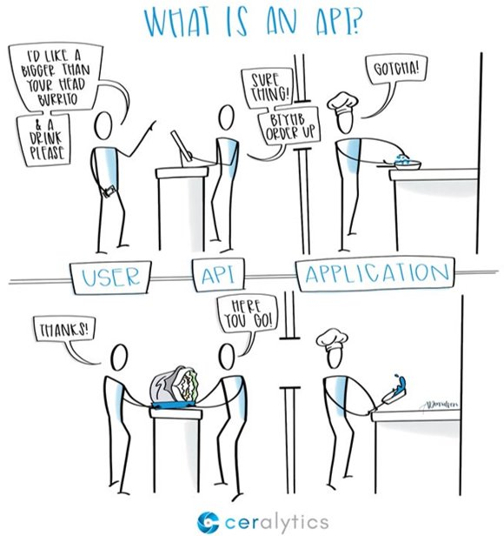
Ordering a Meal
Customer makes an order
Server takes down order, processes it, and passes it to cook
Cook acknowledges order
Cook makes the order and gives it to the server
Server gives the customer their order

Slide 7
APIs
User (client) makes a request
API takes down request​, processes it, ​and passes it to the application​
Application acknowledges request​
Application processes request​ and signals API​
API returns a response to user​

Slide 8
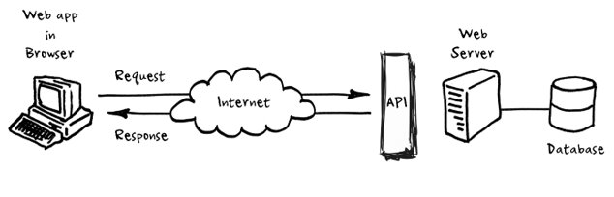
Follows specific programmatic rules
Contains content in an expected and structured format

Slide 9
APIs
Is NOT the database or the server – it is the code that governs the access point(s) for the server
APIs cover a broad category that includes all interfaces that facilitate communication between computer applications
We’re talking about Web APIs – APIs that expose an application’s data and functionality over the internet, allowing two computers (the client and the server) to interact with each other to request and provide data.

Slide 10
4 main types of web APIs
Open / public APIs – no restrictions to access
Partner APIs – requires specific rights and/or licenses
Internal APIs – designed for internal use within an organization
Composite APIs – combines different data and service APIs

Slide 11
Why Use an API?

Slide 12
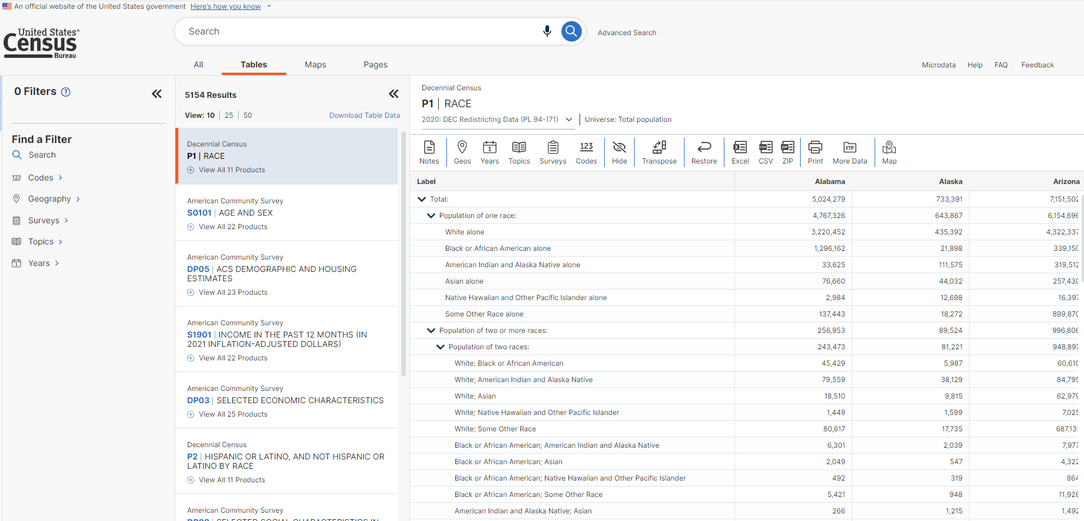

Slide 13
APIs for Research
Get clean and curated data directly from a source​
Websites are designed to be easy for humans to read, not for computers. Web scraping often requires additional cleaning and parsing of the data.​
Data pulled from an API is usually formatted to be immediately usable.
Get access to most recent, up-to-date data​
Integrate and automate your data collection workflow ​
APIs can let you forgo the process of manually download datasets from a website, managing the data in a file management system, and loading it into the software you are using for analysis. ​

Slide 14
Working with an API

Slide 15
1
Explore the documentation for the API
2
Make your request
3
Review response

Slide 16
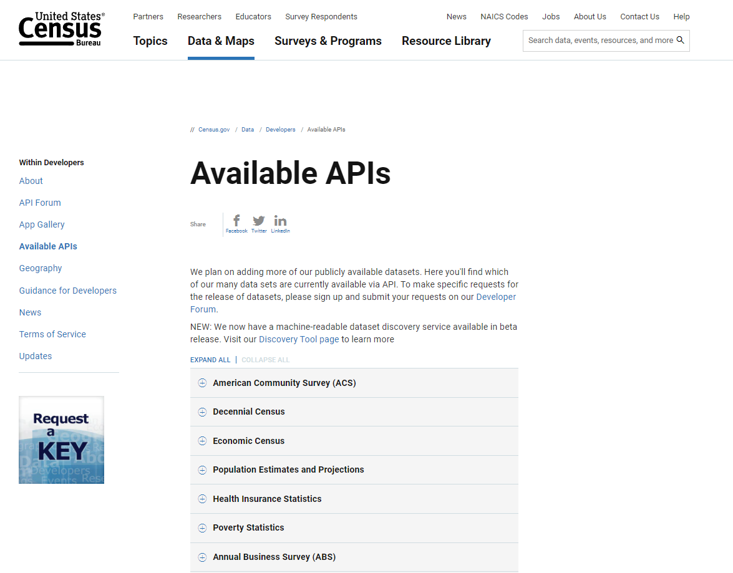
1
Explore the documentation for the API
Do they supply an API that does what you’re looking for?
Review the process for getting access to the API:
Do you need to apply / create an account?
Applying for an API key – unique identifier to authenticate your particular requests
Query limits (if any)
2
Make your request
3
Review response
https://www.census.gov/data/developers/data-sets.html

Slide 17
1
Explore the documentation for the API
Do they supply an API that does what you’re looking for?
Review the process for getting access to the API:
Do you need to apply / create an account?
Applying for an API key – unique identifier to authenticate your particular requests
Query limits (if any)
2
Make your request
Prepare the URL
Query the API
3
Review response
Get the response
Convert response to a dataframe

Slide 18
US Census Data API
https://www.census.gov/data/developers/guidance.html
Available data
American Community Survey (ACS)​, Economic Indicators Time Series​, Decennial Census, Economic Census​, County Business Patterns and Nonemployer Statistics​, Population Estimates and Projections​, International Trade, etc…​
Query small quantities of data (up to 50 variables in a single query, and up to 500 queries per IP address per day)​
To make more than 500 queries per IP address per day, request an API key

Slide 19
Creating Queries in a Browser
https://api.census.gov/data/2018/pep/charagegroups?get=POP,GEONAME,DATE_DESC&DATE_CODE=11&RACE=10&for=county:*&in=state:24

Slide 20
Creating Queries in a Browser
https://api.census.gov/data/2018/pep/charagegroups?get=POP,GEONAME,DATE_DESC&DATE_CODE=11&RACE=10&for=county:*&in=state:24
1. Start with the host name

Slide 21
Creating Queries in a Browser
https://api.census.gov/data/2018/pep/charagegroups?get=POP,GEONAME,DATE_DESC&DATE_CODE=11&RACE=10&for=county:*&in=state:24
1. host name
2. Add dataset name
(list available at https://api.census.gov/data.html)

Slide 22
Creating Queries in a Browser
https://api.census.gov/data/2018/pep/charagegroups?get=POP,GEONAME,DATE_DESC&DATE_CODE=11&RACE=10&for=county:*&in=state:24
1. host name
2. Add dataset name
(list available at https://api.census.gov/data.html)
3. Add variable requests using ?get=

Slide 23
Creating Queries in a Browser
https://api.census.gov/data/2018/pep/charagegroups?get=POP,GEONAME,DATE_DESC&DATE_CODE=11&RACE=10&for=county:*&in=state:24
1. host name
2. Add dataset name
(list available at https://api.census.gov/data.html)
3. Add variable requests using ?get=
4. Filter variables using &for=

Slide 24
Creating Queries in a Browser
https://api.census.gov/data/2018/pep/charagegroups?get=POP,GEONAME,DATE_DESC&DATE_CODE=11&RACE=10&for=county:*&in=state:24
1. host name
2. Add dataset name
(list available at https://api.census.gov/data.html)
3. Add variable requests using ?get=
4. Filter variables using &for=
5. If needed, add your key using &key=
Click here to see RESULT

Slide 25
Creating Queries in a Browser
https://api.census.gov/data/2018/pep/charagegroups?get=POP,GEONAME,DATE_DESC&DATE_CODE=11&RACE=10&for=county:*&in=state:24
1. host name
2. Add dataset name
(list available at https://api.census.gov/data.html)
3. Add variable requests using ?get=
4. Filter variables using &for=
5. If needed, add your key using &key=
Making queries in your browser is a good way to practice and get ​comfortable with the variables and filters available in the Census Data API​
Works best on Chrome or Firefox​
In web browser, right-click and select “Save As” to save results as a csv​
Sample queries: ​ https://www.census.gov/data/developers/guidance/api-user-guide.Example_API_Queries.html

Slide 26
Demonstrations

Slide 27
Demo 1
Install and load RJSONIO – a package that converts data to and from JSON format
Structure mimics creating API queries in a browser
Works – but tedious. You need to make sure you understand the structure of your data well, and convert JSON to R objects.

Slide 28
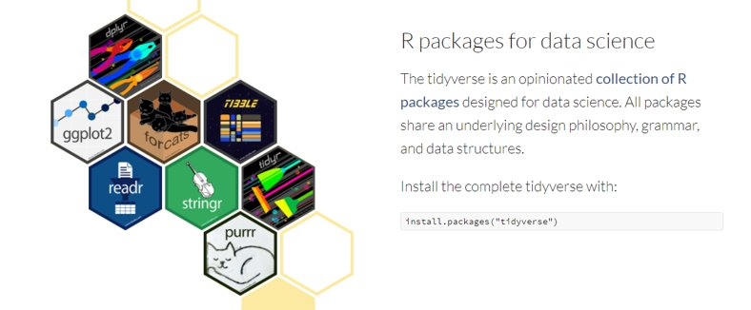
Demo 2
tidycensus: an integrated package that allows users to access decennial census and ACS data as tidyverse-ready data frames. ​
tidyverse: collection of R packages designed for data science. ​ (come to our other R workshops to learn more about this collection)

Slide 29
Demo 3
censusapi: R wrapper for US Census Data API. ​
​Covers more datasets than tidycensus. ​
Returns data frames of census data and metadata for Decennial, ACS, Small Area Health Insurance Estimates, Small Area Income and Poverty Estimates, Population Estimates and Projections, etc. ​

Slide 30

Fall 2022 Data Bytes Schedule
GIS and Maps
Programming
All sessions are on Mondays from 12 to 1 pm.
Finding Maps and Map Data
Speeding up your Python Code
More info at: bit.ly/data-bytes
Sept 12th
Oct 10th
Choosing a Python IDE
Introduction to Leaflet
Sept 19th
Oct 17th
Thank you
for attending!
Please complete our survey at:
bit.ly/data-bytes-survey
Creating Infographics in
Business Analyst
Advanced StoryMaps
Tips and Tricks
Sept 26th
Oct 24th
Debugging your Python Code
Introduction to APIs in R
Oct 3rd
Oct 31st

Slide 31
Questions?

